Slide 1
REWARD PLATFORM

Slide 2
TEAM MEMBERS:
2010030436_K.DIMPLE
2010030438_K.SIRISHA
GUIDED BY:
Dr. P Lalitha Surya Kumari

Slide 3
PROBLEM STATEMENT:
Rewards Platform is a Blockchain-based solution for keeping track of customer reward points, creating a shared transaction ledger between all involved brands.

Slide 4
INTRODUCTION:
Introducing blockchain as a customer loyalty :
Customer loyalty and engagement can make or break companies, and as such, rewards programs represent strategic investments for all types of organizations. But as they have been growing rapidly, they are also still ailing due to inefficiencies. There are several reasons for this, but first and foremost is we believe the paucity of uniform management systems is a primary source of members’ lack of activity.

Slide 5
Key benefits for loyalty rewards programs:
Loyal customers are one of the primary drivers of any for-profit business. By building loyalty rewards programs, companies aim to heighten the customer experience. In many cases, however, the opposite has occurred. The implementation of blockchain can drive the customer experience to the next level, Loyal customers are one of the primary drivers of any for-profit business. By building loyalty rewards programs, companies aim to heighten the customer experience. In many cases, however, the opposite has occurred. The implementation of blockchain can drive the customer experience to the next level and this can be done by :
1. Reducing costs 2. Enabling a frictionless system 3. Making the process near real-time 4. Providing a secure environment 5. Creating unique business opportunities

Slide 6
Blockchain revolution for crypto reward programs:
Customer loyalty programs offer direct financial benefits to companies, and also better customer information for strategic decision-making. According to a Tuck School of Business at Dartmouth study, crypto and points reward programs incentivize customers to complete more purchases if there’s a reward in place. In consequence, companies can increase loyalty, reduce CAC and increase sales.
BENEFITS:
1.Crypto-linking or card-linked rewards 2. global nature of cryptocurrencies
3. limit a company’s financial 4.marketing opportunity.

Slide 7
SURVEY:
S.NO. | TITLE | IMPLIMENTATION
1. | Rewarding reviews with tokens: An Ethereum-based approach | proposes a general decentralized rating framework based on blockchain, supporting recommender systems and rewarding its users for their reviews to compensate them for the cost they incurred due to the permissionless blockchain
2. | Online service or virtual community? Building platform loyalty in reward-based crowdfunding | research focused on campaign success, , this study extends the scope of research to the relationship between individual contributors and crowdfunding platforms.
3. | Blockchain-Based Cross-Organizational Integrated Platform for Issuing and Redeeming Reward Points | The implementation of reward points is the smart contract running on the blockchain. Whenever a request for transferring reward points arises or getting the information about the point state, the function calls are invoked to trigger the corresponding functions in the point smart contract.

Slide 8
GITHUB COMMITS:
KLH-IBCC/3.-Reward-Platform-Blockchain-Based-Issue-of-Customer-Loyalty-Points- (github.com)

Slide 9
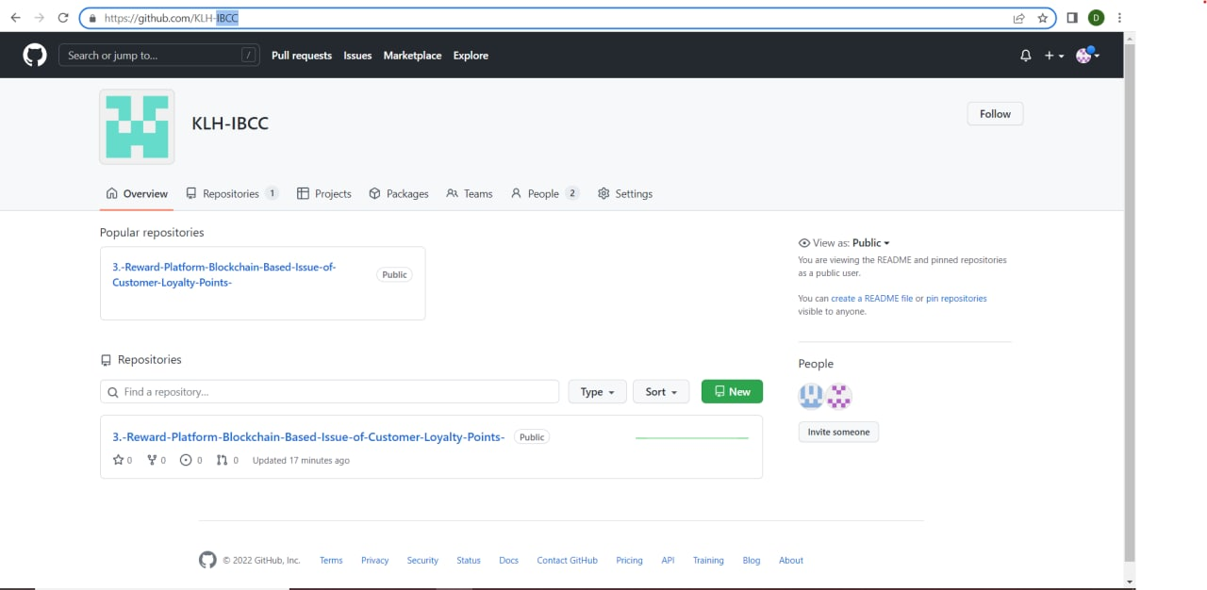

Slide 10
CONCLUSION:
Cryptocurrencies are changing fast, and they’re changing the financial scenario at the same speed. Blockchain technology is one of the best mechanisms for redeeming digital rewards in the form of crypto assets. The ability to issue a desirable reward is crucial for those companies that want to succeed in the new era of digital money.

Slide 11
REFERENCES:
https://www2.deloitte.com/us/en/pages/financial-services/articles/making-blockchain-real-customer-loyalty-rewards-programs.html
https://www.bigcommerce.com/blog/customer-loyalty-blockchain/#6-cases-for-blockchain-loyalty-tokens
https://www.reloadly.com/blog/crypto-rewards-program/

Slide 12
THANK
YOU

